Slide 1
The Evolution of Leadership in Accounting and Finance
Shaler N. Tate

Slide 2
Who is shaler tate and what qualifies him to speak about leadership?
NOTHING

Slide 3
What is a leader?
Someone with a title?
The loudest one in the group?
The smartest one in the group?
Someone that gives orders?
Someone that is a team player?
The most experienced one in the group?
Someone with really good hair?
ANYONE

Slide 4
What does a leader look like?

Slide 5
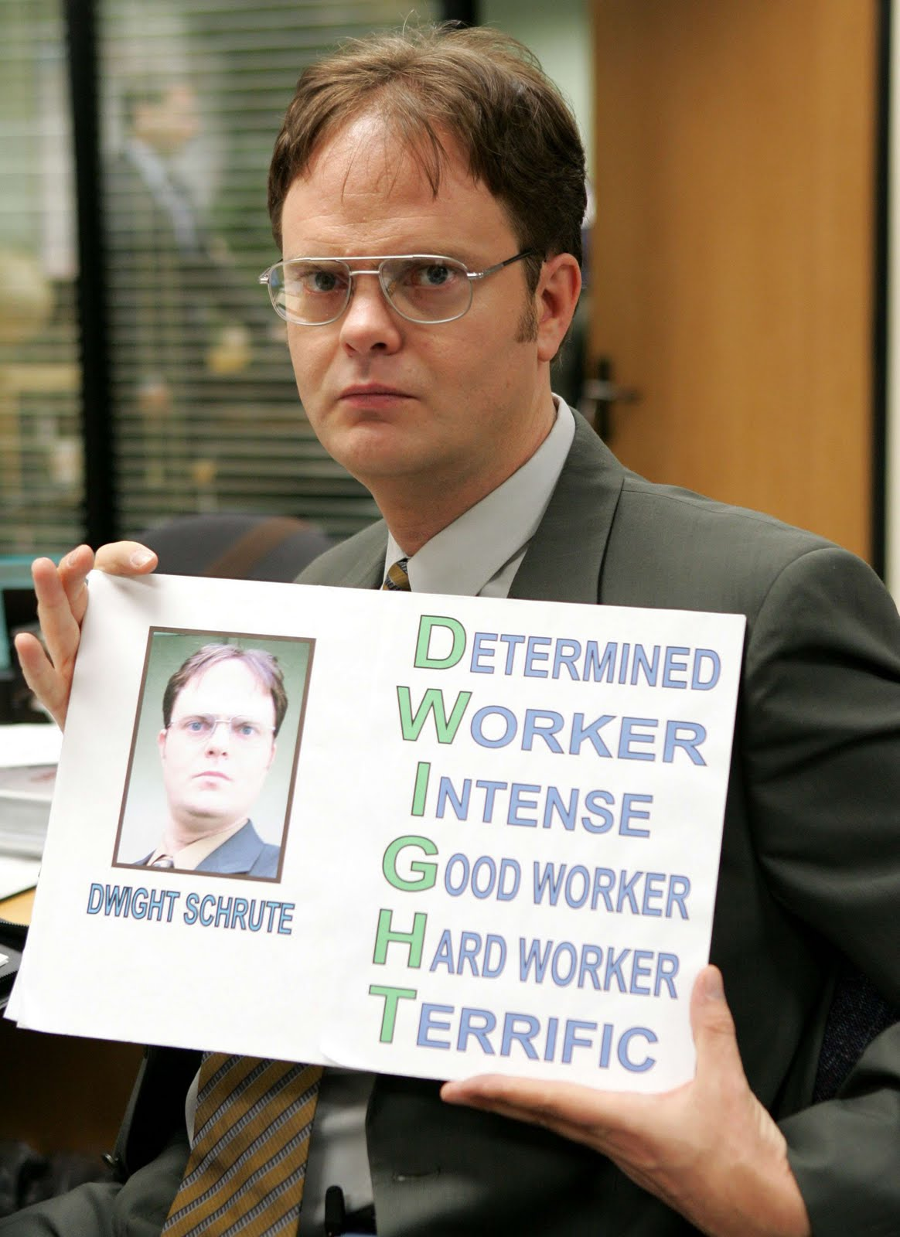
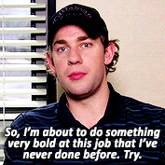
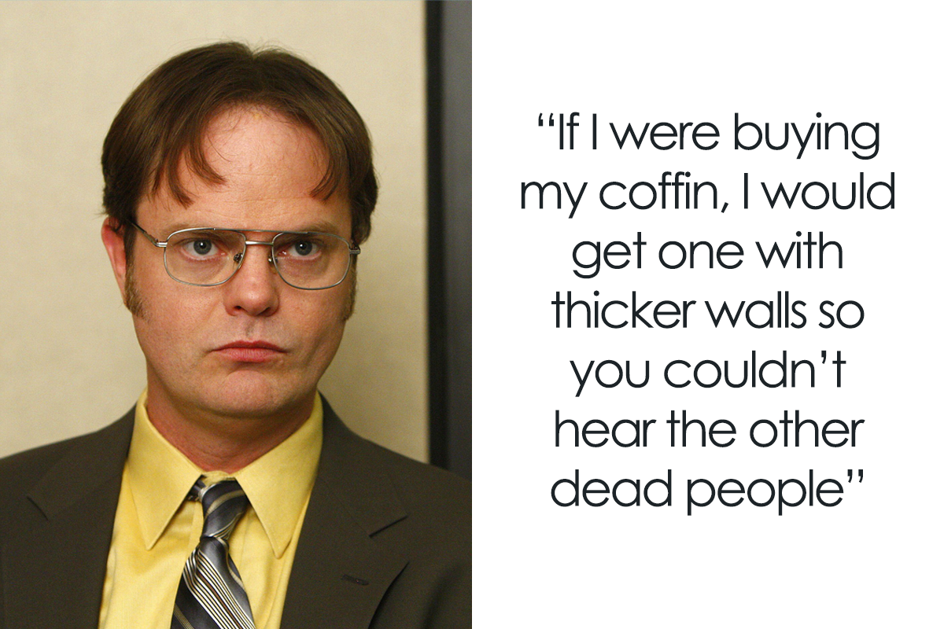
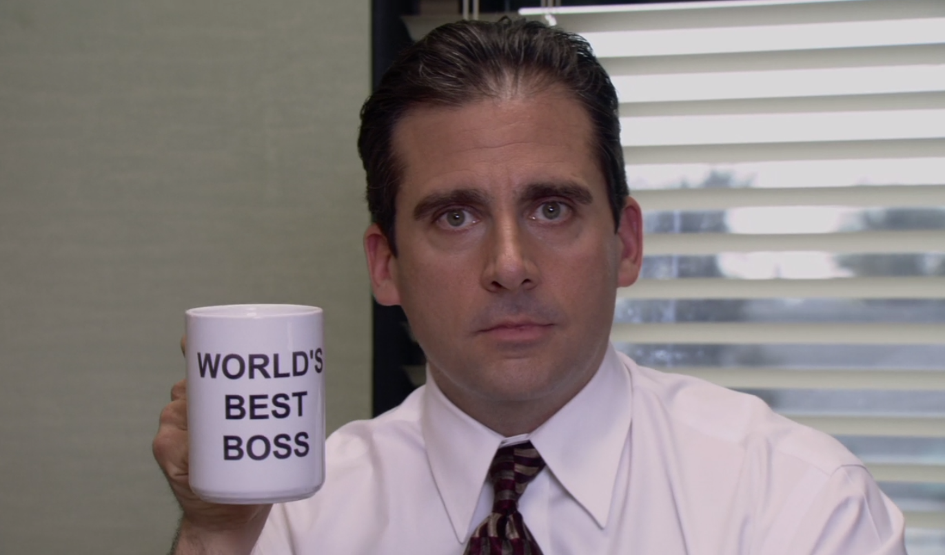
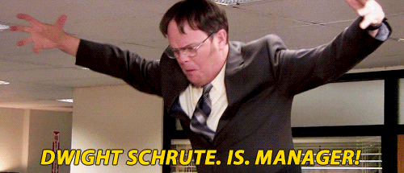
Types of leaders
Jim:
Likable
Cool
Laid Back
Smart
How would I describe myself? Three words:
Hard working, Alpha Male, Jackhammer.
Merciless. Insatiable.
Michael:
Funny
People Centric
Unpolished
Caring
Dwight:
Passionate
Profit Centric
Hard working
Motivated

Slide 6
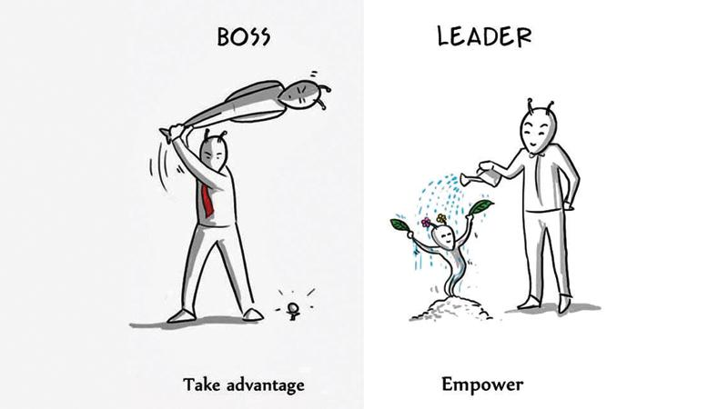
How it started vs. how it’s going
Profit-centric vs. People-centric
Strict vs. Flexible
Formal vs. Informal
Long Hours vs. Work Life Balance
Quantity vs. Quality
Authoritative vs. Collaborative
Negative Reinforcement vs. Positive Reinforcement
Threatened by Talent vs. Empowered by Talent
Insensitive vs. Emotionally Intelligent (EQ)
This is all pretty recent.

Slide 7
Emotional Intelligence
“Blanket Management” simply does not work.
Understanding the complexities of each individual is critical.
Adapting your management style for each individual is more successful.
Empathy goes a long way.
“You don’t inspire your teammates by showing them how amazing you are. You inspire them by showing them how amazing they are.”
- Robyn Benincasa

Slide 8
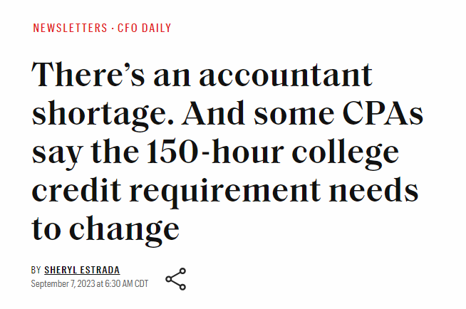
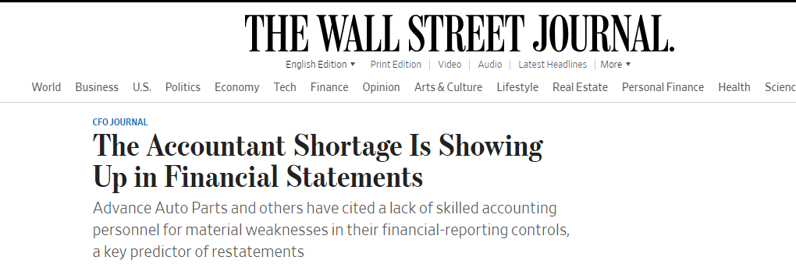
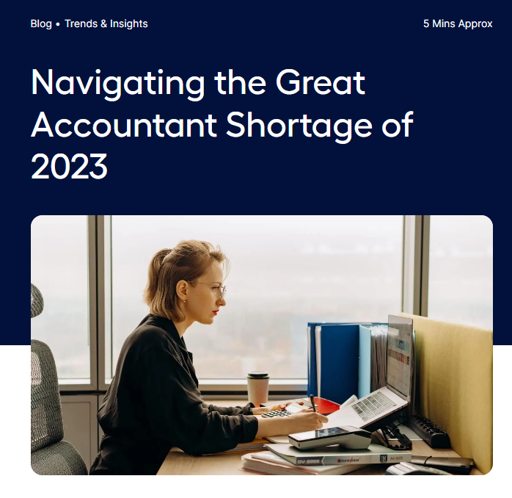
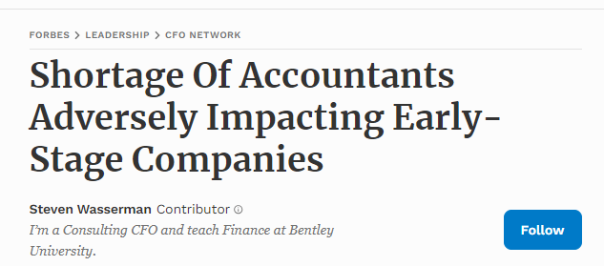
Why Does this matter?

Slide 9
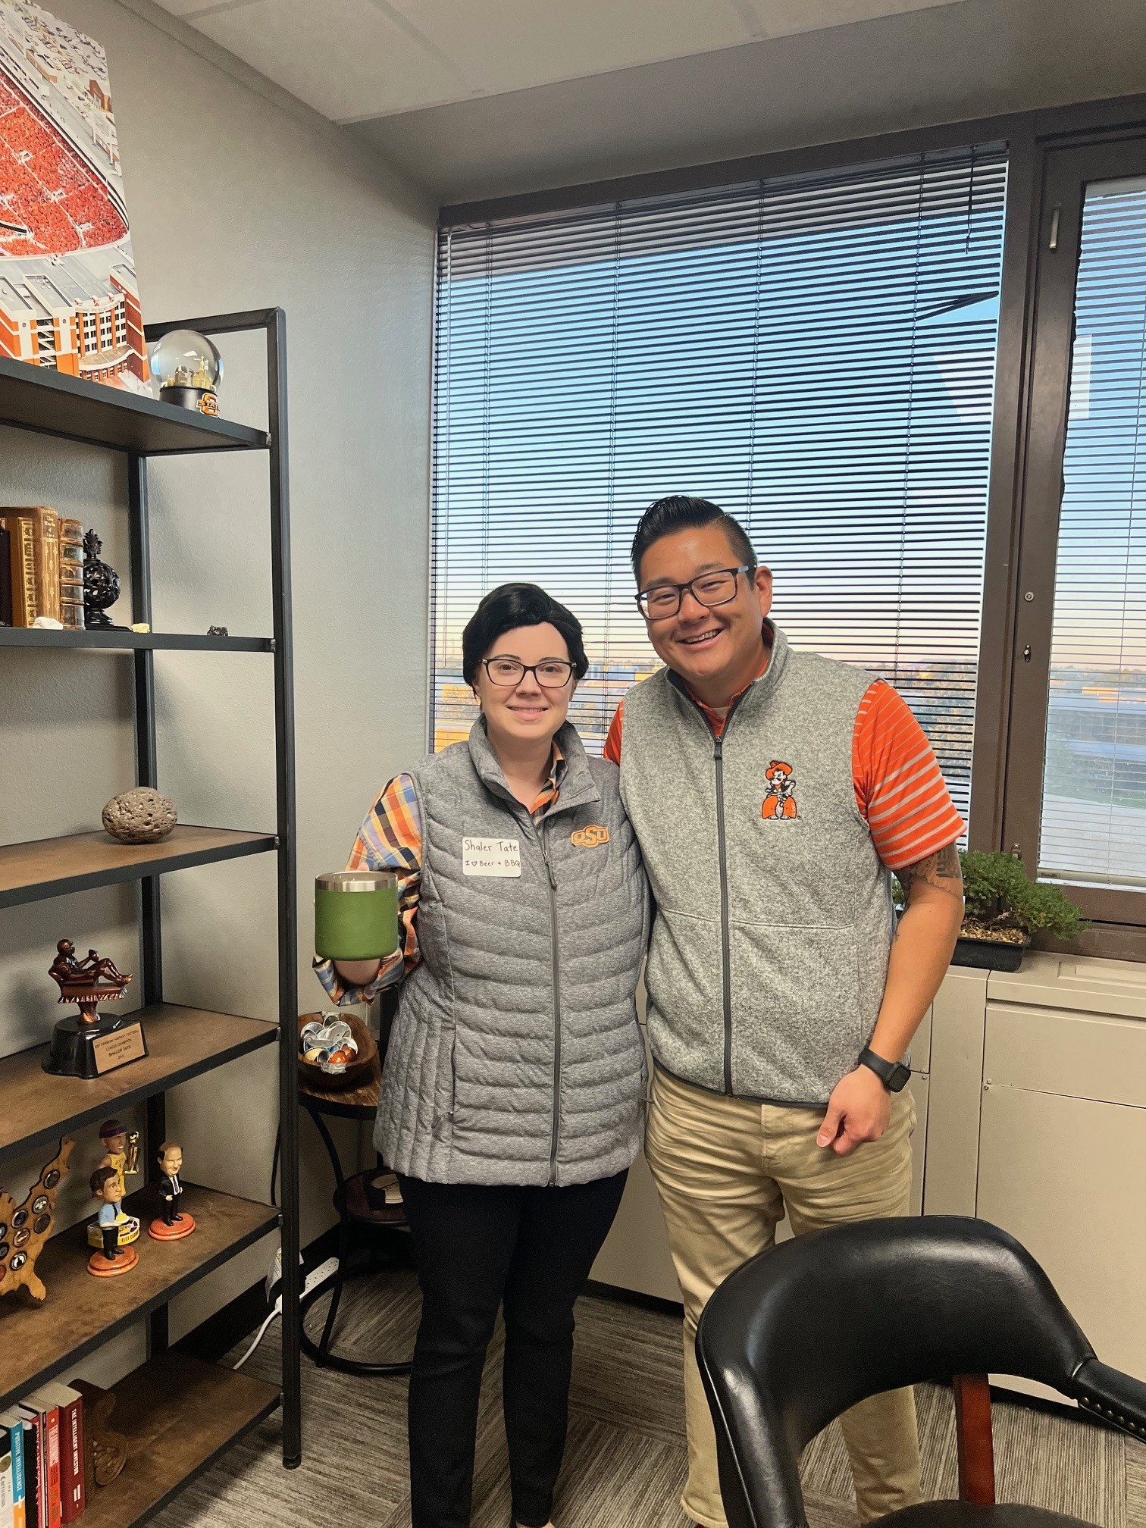
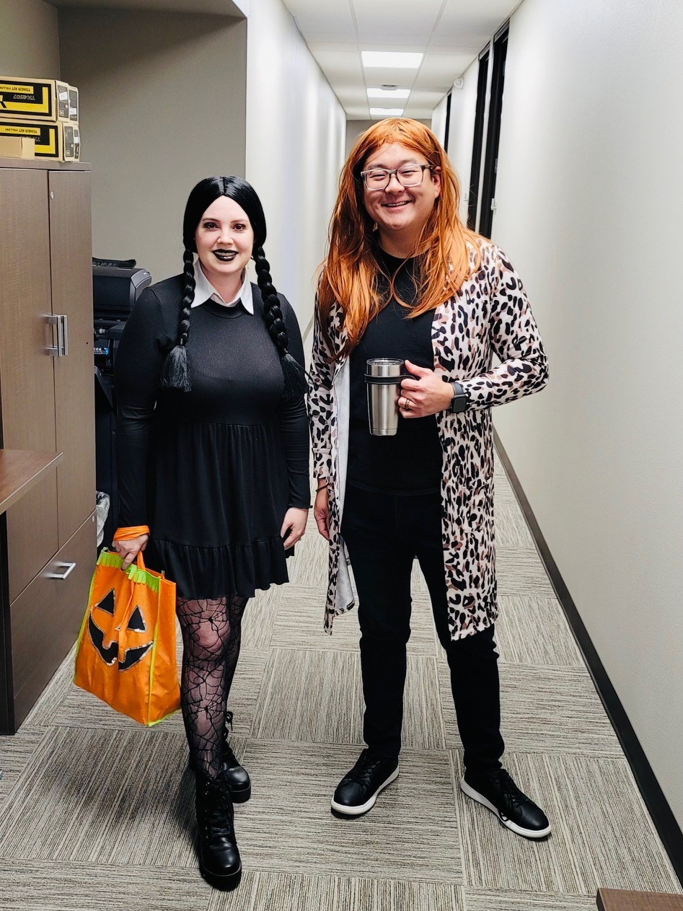
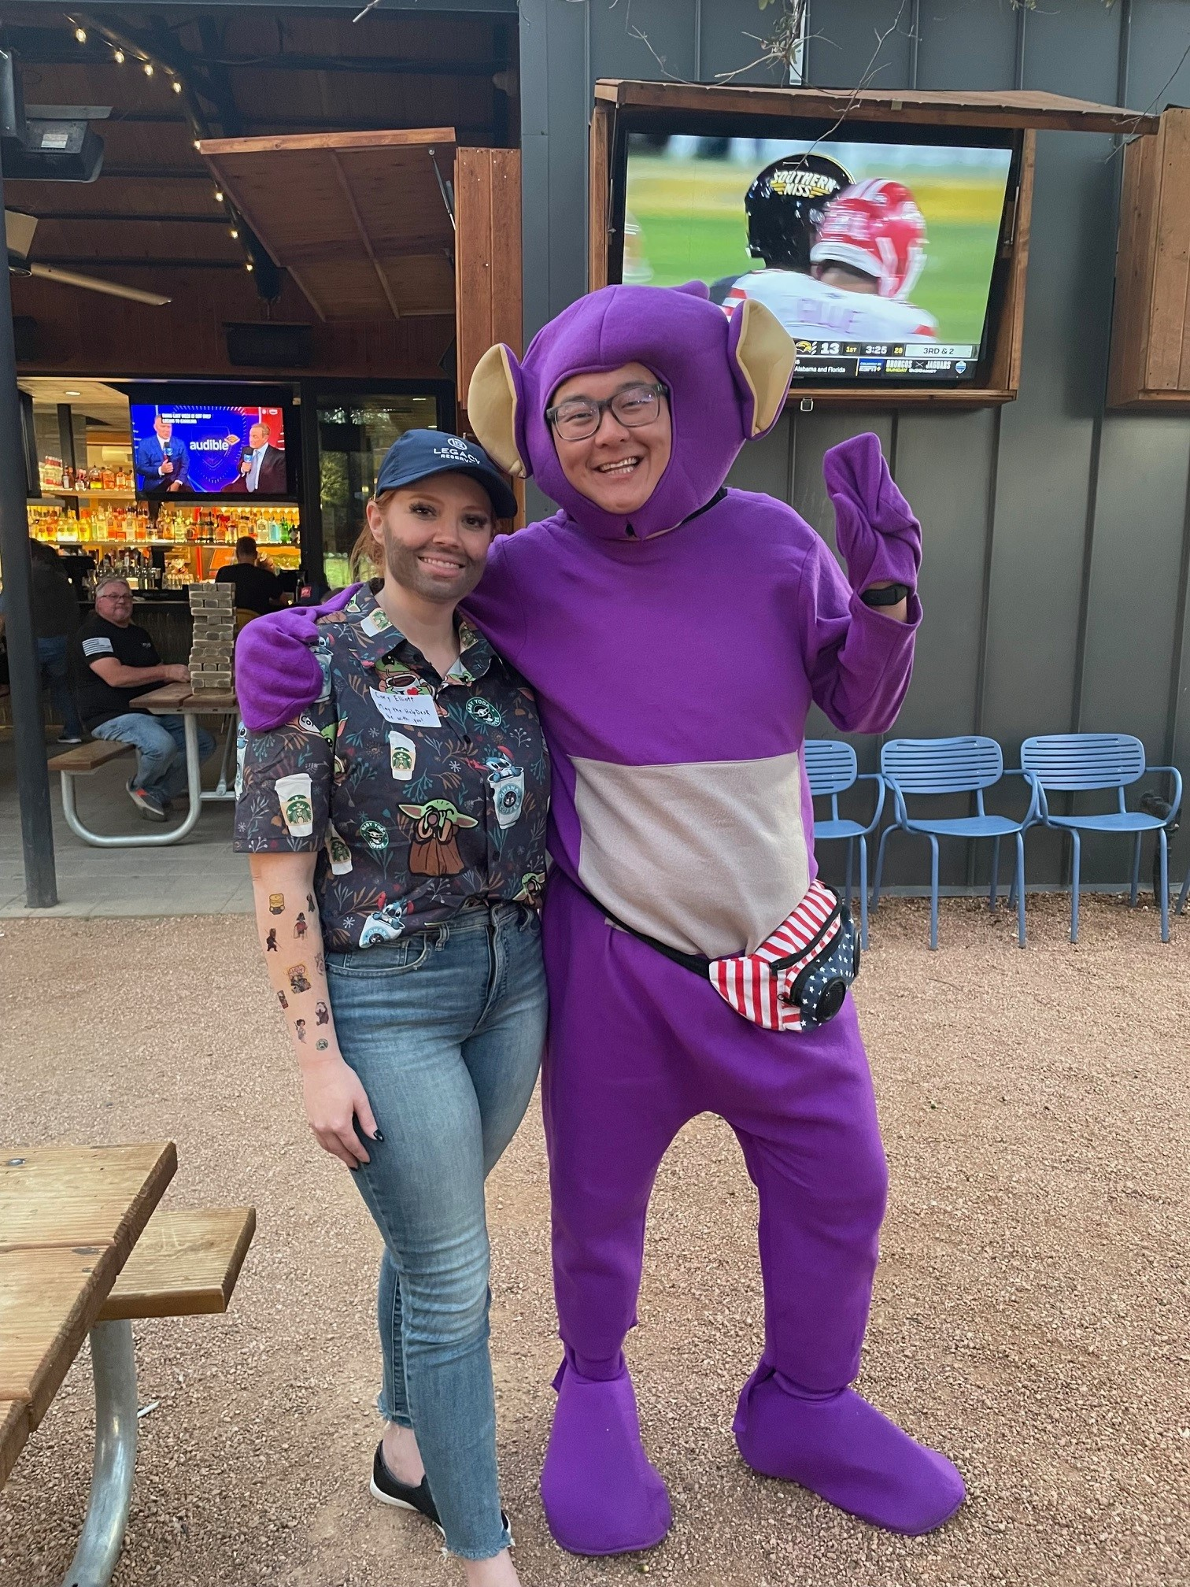
Personal Successful methods
Get to know your team.
Be empathetic and understanding.
Be flexible.
Understand that everyone is an individual.
Adapt as things change.
Don’t take yourself too seriously. You’re not that big of a deal.
Have FUN with you staff.

Slide 10
Key to Guaranteed Leadership success
CARE

Slide 11
Questions?

